Slide 1
Bjarne Stroustrup: "There are only two kinds of programming languages: those that people complain about and the ones that nobody uses."

Slide 2
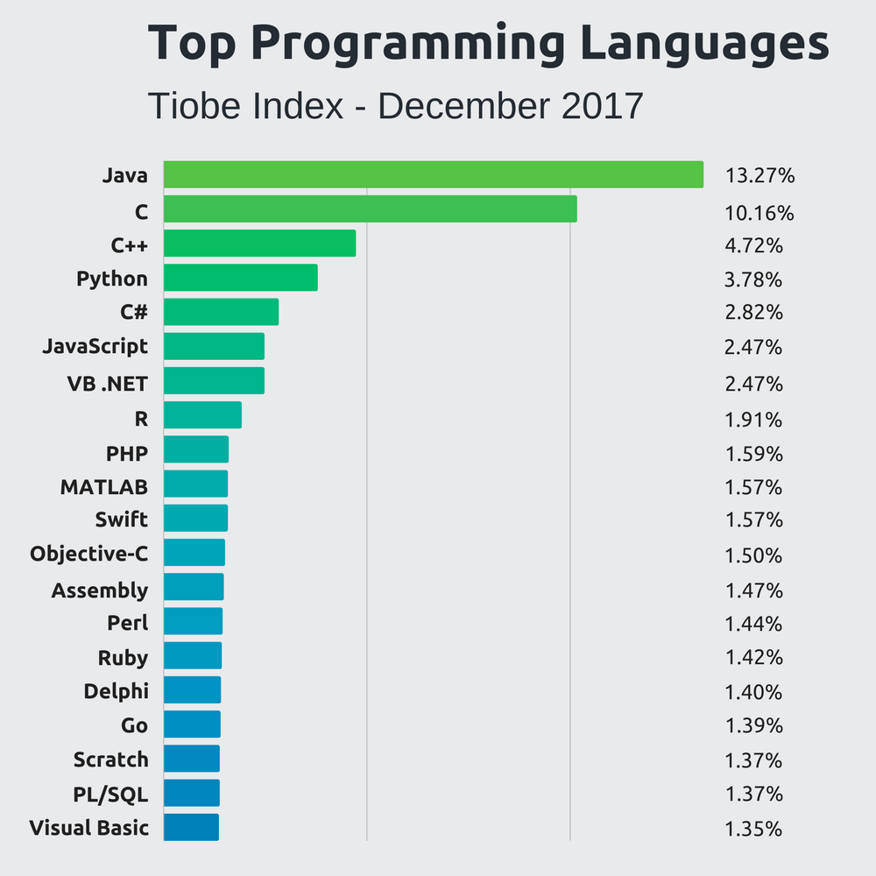

Slide 3
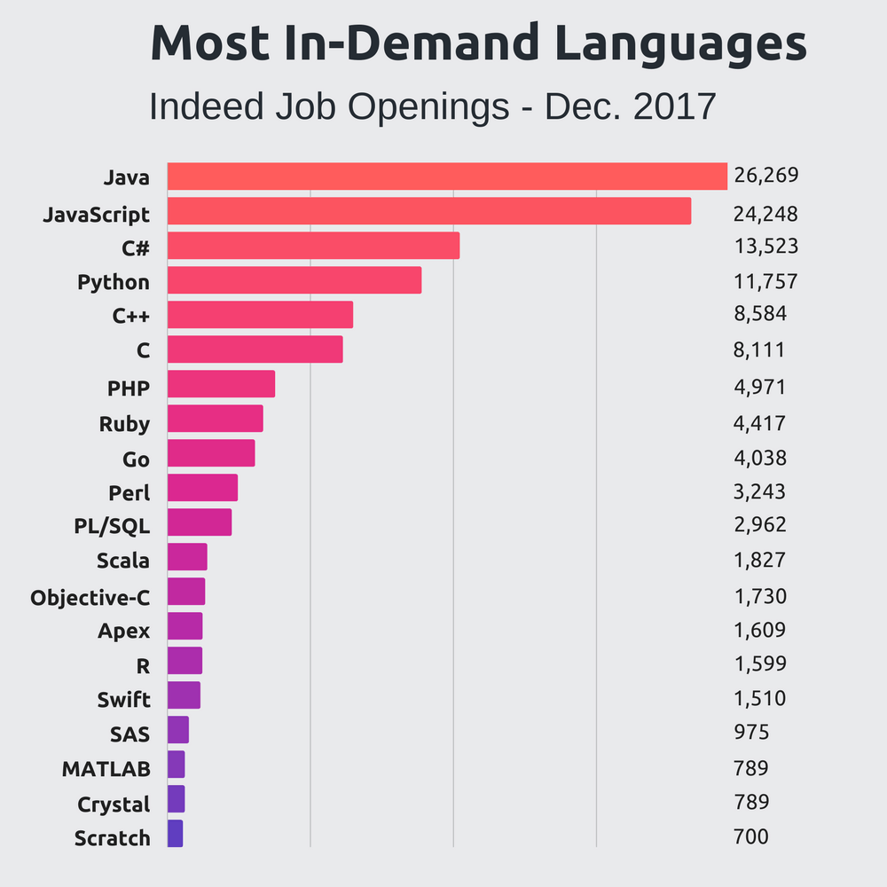

Slide 4
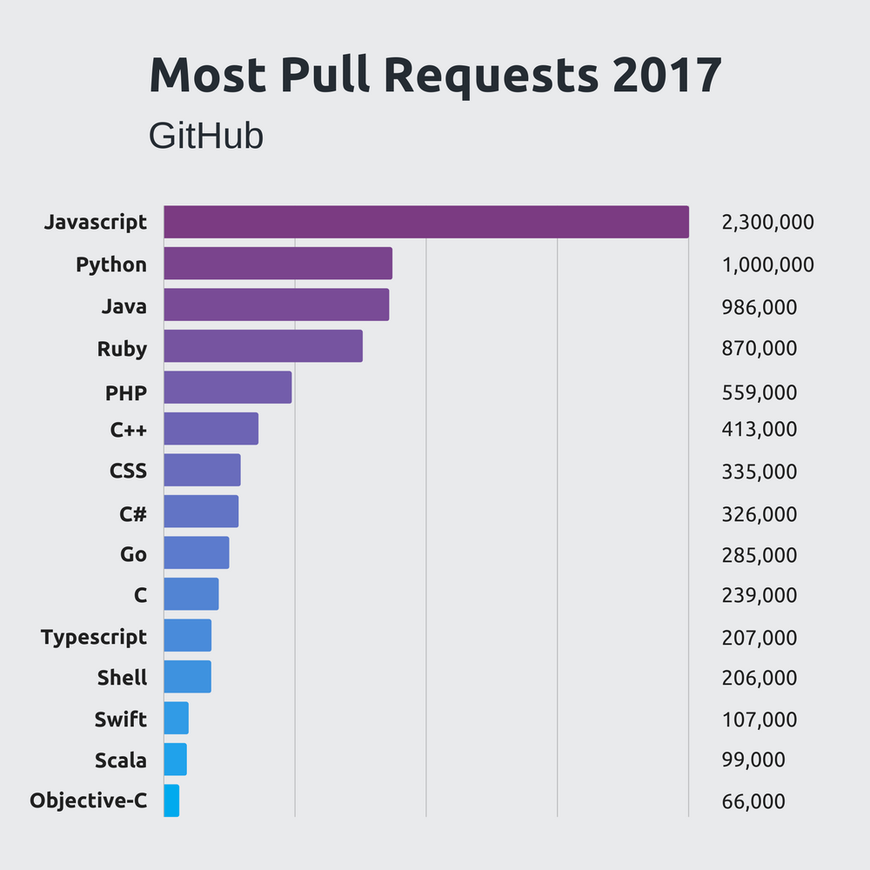

Slide 5


Slide 6
Nog meer fun facts

Slide 7
JIT COMPILER

Slide 8
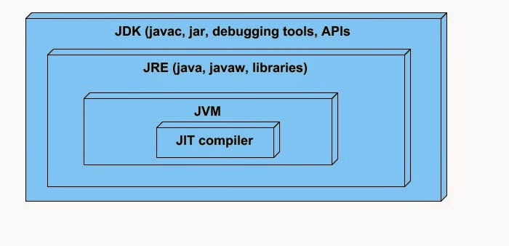

Slide 9
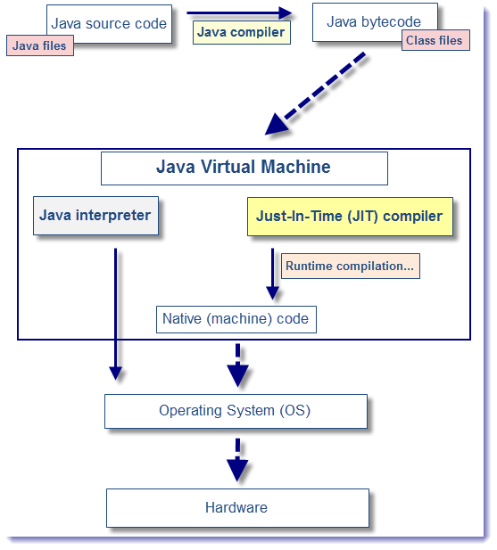
Notes:
Werking JVM
classes contain platform-neutral bytecodes => JVM => different architectures.
JVM loads class files, determines semantics of bytecode => performs computation => slow
Oplossing
method compiled, the JVM calls the compiled code of that method directly instead of interpreting it.
Hoe?
JVM maintains an invocation count => starts at a predefined value => decremented when method is called.
if zero => just-in-time compilation for the method is triggered.
optimization levels: cold, warm, hot, veryHot, or scorching
Higher =better performance => higher CPU and memory useage
default = warm, sometimes cold to improve startup time.
Voordeel
improves the performance -> compiling bytecodes to native machine code at run time.
Nadeel
JIT compilation does require processor time and memory usage => significantly affect startup time
Doel
optimal balance between startup times and long-term performance.

